Slide 1
BISMILLA HIR RAHHMA NIRRAHIM. ASSALAMUALIKUM WR WB. NAME: NAZIMA PARVEEN AND SHIREEN MANSOOR. TOPIC: HAJ. GROUP: SIS IRAM USMAN. COURSE: SABEEL-UL-JANNAH 2015.

Slide 2
What Are the Five Pillars of Islam?
The Five Pillars of Islam are the framework of the Muslim life. They are the testimony of faith, prayer, giving zakat (support of the needy), fasting during the month of Ramadan, and the pilgrimage to Makkah once in a lifetime for those who are able.
IN THIS PRESENTATION WE ARE GOING TO SEE IN DETAIL ABOUT HAJ .

Slide 3
5. Pillars of islam.
1. KALIMA.
2.NAMAZ.
3.ROZA.
4.ZAKAT.
5.HAJ.

Slide 4
Hajj ka mahina
HAJJ is performed in the zil hajj
MEENA.
ARFAT.
MUZDALIFA (JAMRAAT).
SAFA AUR MARWA.
KHURBANI.

Slide 5
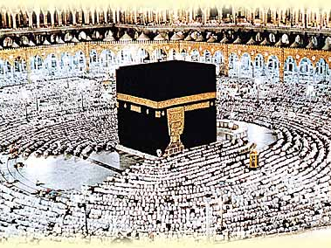
Pilgrims praying at the Haram mosque in Makkah. In this mosque is the Kaaba (the black building in the picture) which Muslims turn toward when praying. The Kaaba is the place of worship which God commanded the Prophets Abraham and his son, Ishmael, to build.

Slide 6
5) The Pilgrimage to Makkah
The annual pilgrimage (Hajj) to Makkah is an obligation once in a lifetime for those who are physically and financially able to perform it. About two million people go to Makkah each year from every corner of the globe. Although Makkah is always filled with visitors, the annualHajj is performed in the twelfth month of the Islamic calendar. Male pilgrims wear special simple clothes which strip away distinctions of class and culture so that all stand equal before God.

Slide 7
RITES OF THE HAJJ .
The rites of the Hajj include circling the Kaaba seven times and going seven times between the hillocks of Safa and Marwa, as Hajera did during her search for water. Then the pilgrims stand together in Arafa and ask God for what they wish and for His forgiveness, in what is often thought of as a preview of the Day of Judgment.

Slide 8
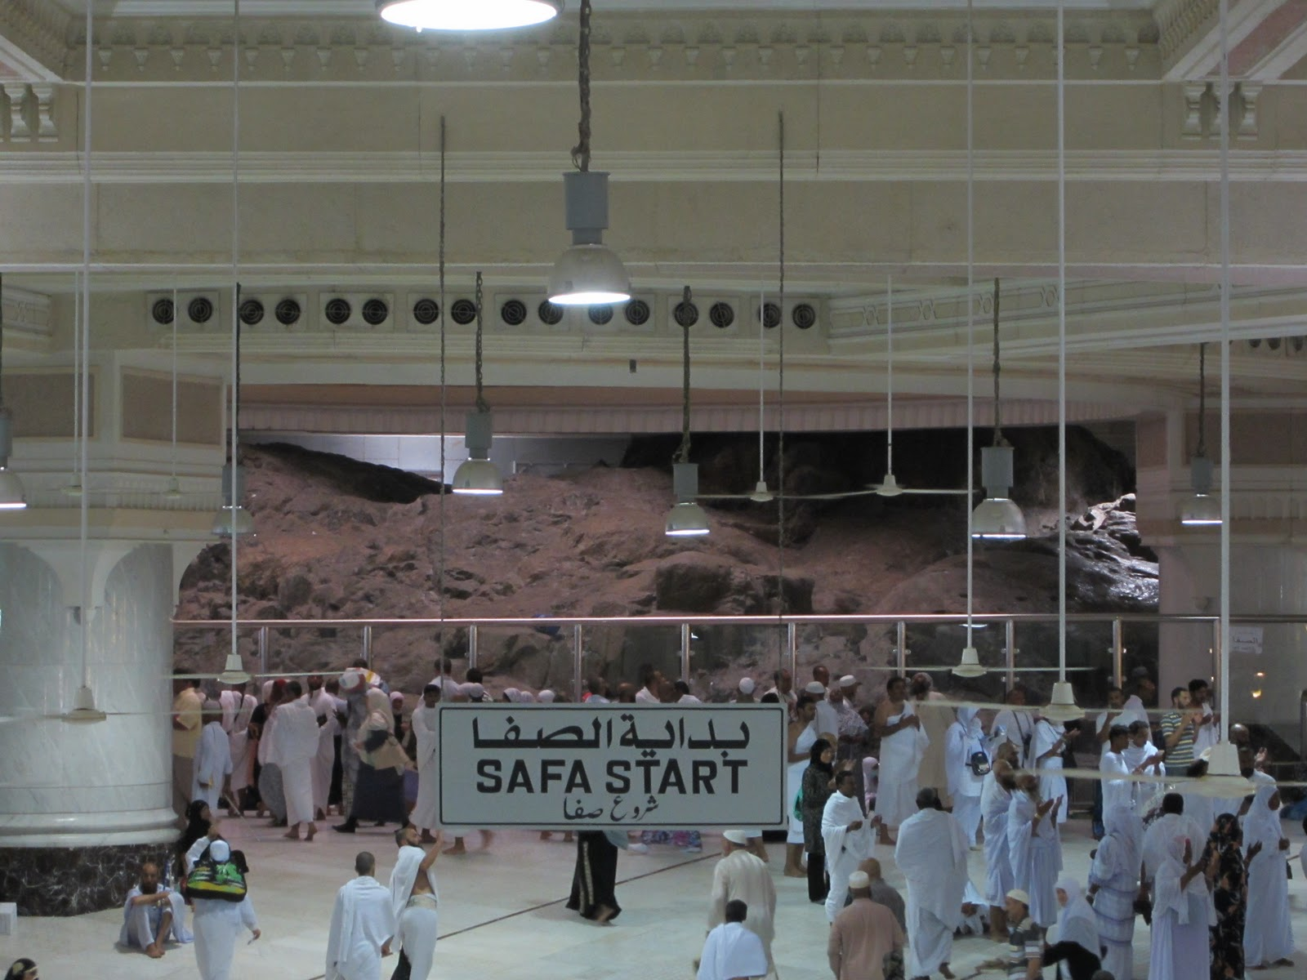
SAFWA AUR MARWA.
as bibi Hajera did during her search for water. going seven times between the hillocks of Safa and Marwa, at that moment the miracle happen zam zam from that time that water come from ground.

Slide 9
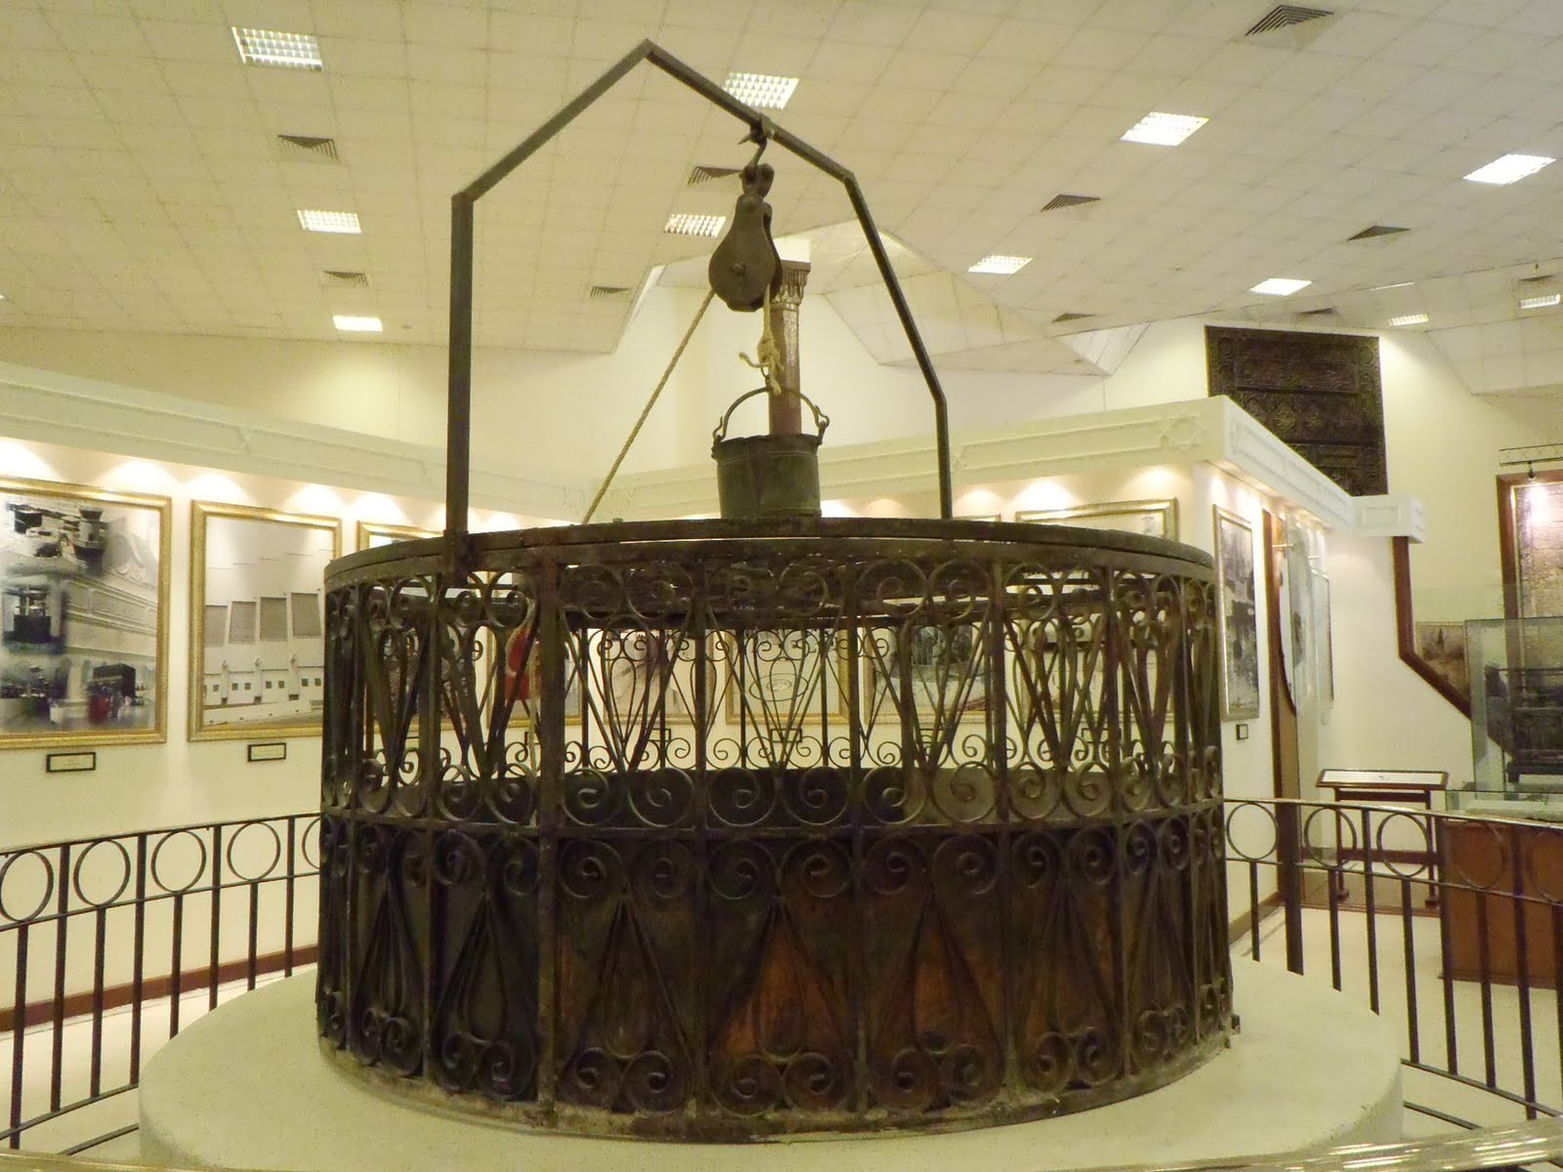
Zam zam well
as bibi Hajera did during her search for water. going seven times between the hillocks of Safa and Marwa, at that moment the miracle happen zam zam from that time that water come from ground.

Slide 10
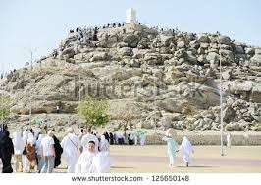
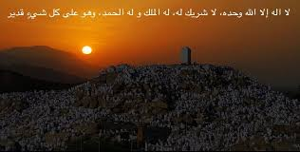
ARAFA.

Slide 11
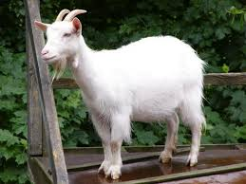
Khurbani.
Allah s.w.t ka hukum tha khurbani dene ka allah ke rahh me UNHO NE IBRAHIM A.S KU HUKUM DIYA KE UNKE BETE ISMAIL A.S KU ALLAH KE RAHA ME KHURBAN KAR DEE AUR KNIFE KO YE HUKUM DIYA KY WO ISMAIL KA BAAL KU BAAKA NA KARE AISE HAI HAMARE ALLAH PAAK KE KHUDRAT.

Slide 12
Ye mere ek chote se koshish hai umeed hai ke aap saab ku pasand aaye . Thanks for seeing this presentation with your patience jazakallah khair..

