Slide 1
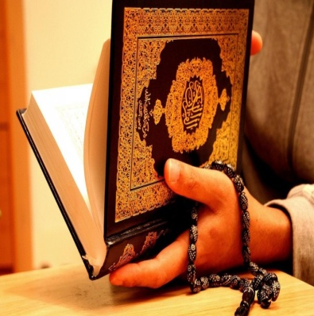
Gaween Gummrah
Al Araf
Ayah 175
Funsalah Quran
Itebae shetan
Notes:
And recite to them, [O Muhammad], the news of him to whom we gave [knowledge of] Our signs, but he detached himself from them; so Satan pursued him, and he became of the deviators.

Slide 2
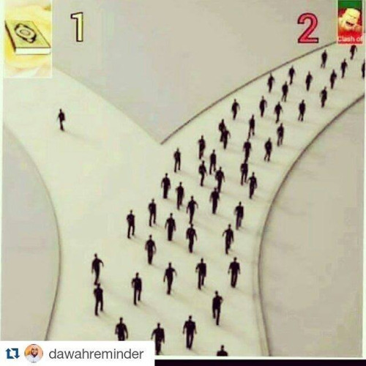

Slide 3
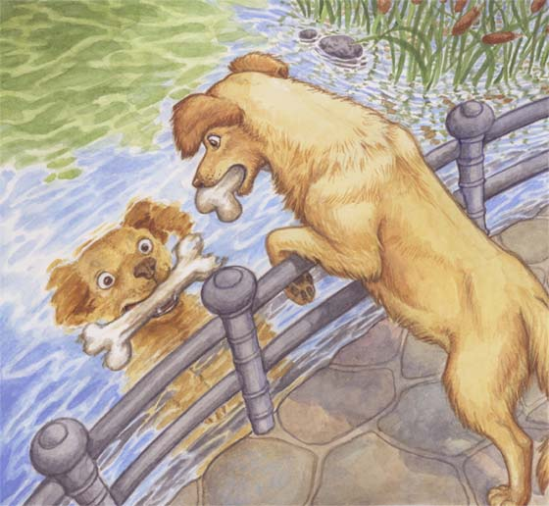
And if We had willed, we could have elevated him thereby, but he adhered [instead] to the earth and followed his own desire. So his example is like that of the dog: if you chase him, he pants, or if you leave him, he [still] pants. That is the example of the people who denied Our signs. So relate the stories that perhaps they will give thought. (7:176)
Allah wants:
Follow Quran n Hadees
Firm Grip
Consistency
Riffat(Superiority)
Taqwa
Hasana fi Duniya and fi Akhirah

Slide 4
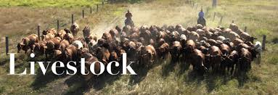
Hube Duniya
And We have certainly created for Hell many of the jinn and mankind. They have hearts with which they do not understand, they have eyes with which they do not see, and they have ears with which they do not hear. Those are like livestock; rather, they are more astray. It is they who are the heedless.

Slide 5
Sabeel ul Jannah 2015
NQSJ15_SS41_Momminah

